Slide 1

Rising Substance Related Deaths & Declining Rehab Admittance: Insights from New York and beyond

Slide 2

Abstract & Focus
This study examines the alarming rise in global drug-related deaths and the declining rates of rehabilitation admissions. Using New York state as a case study, we analyze trends in substance abuse rates, rehab admissions, and the primary drugs used at time of admittance.
The data explores age demographics and substance use patterns to provide insight into broader U.S. trends, highlighting the urgent need for improved intervention and support systems.
Project One – Team Five
Jacob Farley - Shiki Pawan - Amy Ewert - Megan Neal

Slide 3
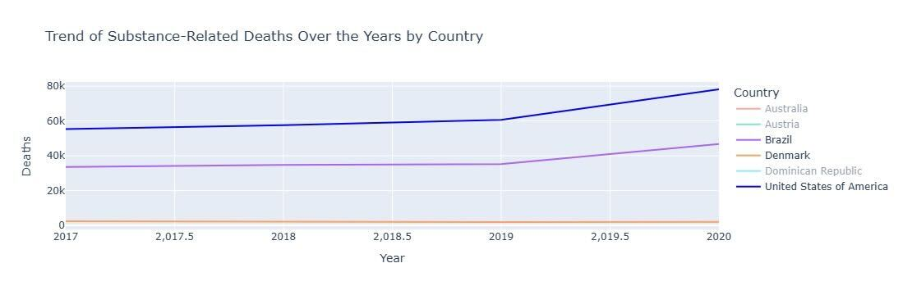
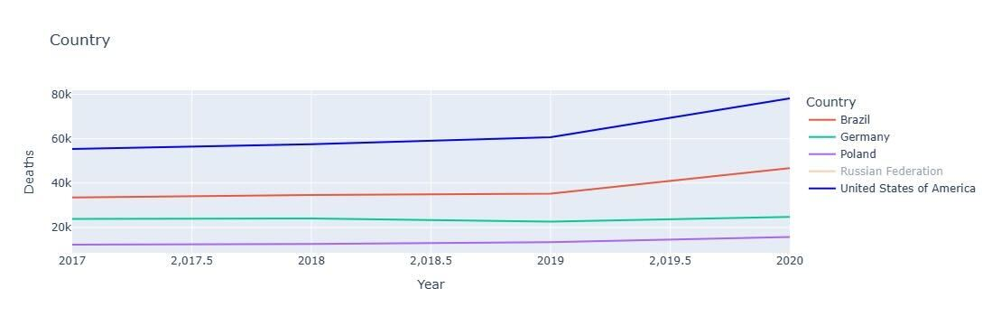
Substance related deaths by country
Substance-related deaths are rising globally, with the U.S. (dark blue) facing a drastic surge.
Notes:
This slide reveals a concerning trend: substance-related deaths are steadily rising worldwide, with the United States experiencing a drastically higher rate than other countries shown. The U.S. line in dark blue highlights an accelerating crisis, far surpassing other nations in both scale and growth.
These findings underscore the urgency of addressing substance abuse through effective interventions and support systems, as we'll see further in our New York case study.

Slide 4
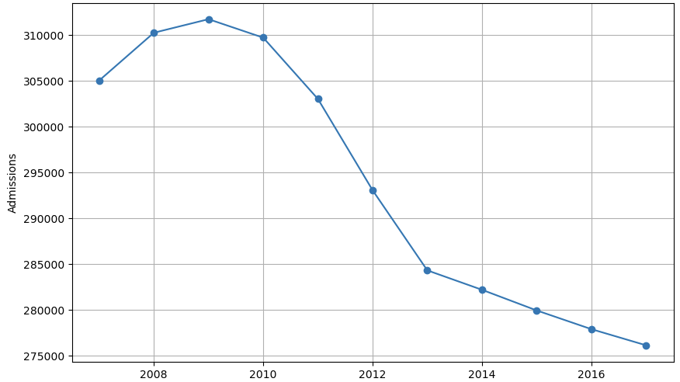
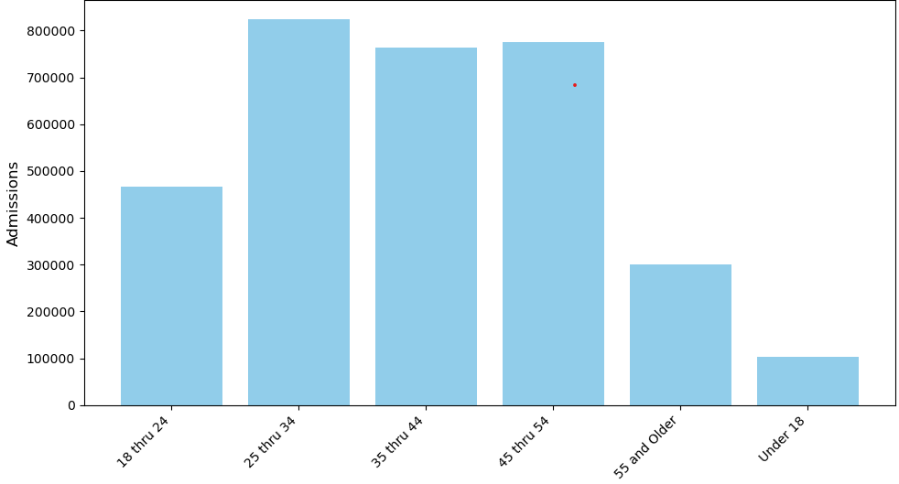
Rehab Admissions Drop Sharply While Doubling in Key Age Groups: What's Driving These changes?
Societal Shifts: Reduced stigma drives younger adults to seek help, but high costs and stigma still deter others.
Financial Barriers: Rising rehab costs and insurance gaps limit access, especially for older adults.
Substance Trends: Potent drugs lead to rapid dependency in younger adults, while overall admissions drop as fewer stay in treatment.
Social Circles: New friendships and social environments in this age group can increase awareness of substance issues, prompting help-seeking.
Independence: Moving off parental insurance allows more private access to rehab, encouraging admissions.
Legal Pressures: Probation or job requirements often mandate rehab, driving higher admissions in this age range.
New York years 2007 - 2017
Notes:
Both could be influenced by societal, Financial, other external factors.
Decline in Overall Admittance:
Rising Costs & Access Barriers: Increasing rehab costs and limited insurance coverage make it difficult for many to afford treatment.
Stigma & Perception Shifts: Persistent stigma around rehab and a growing preference for alternative treatments may deter people from traditional rehab.
Higher Admissions in Ages 25-34 vs. 18-24:
Increased Life Stressors: Ages 25-34 face more pressures with career, finances, and family, potentially driving substance use and rehab admissions.
Legal & Social Mandates: Probation requirements and job-related mandates are more common in this age group, pushing more individuals into rehab.

Slide 5
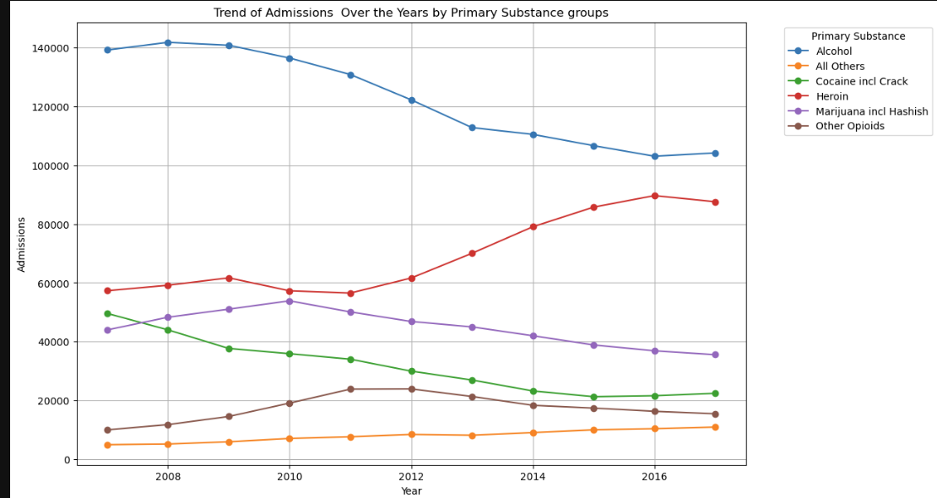
Admission by substance type
Alcohol Declines, Opioids Rise:
Shifting substance patterns reflect the growing opioid crisis.
Age Spike in Admissions:
Admissions double from ages 18-24 to 25-34, highlighting age-related pressures.
New York years 2007 - 2017
Notes:
This line graph highlights trends in substance-related admissions over time. We can see a sharp decline in admissions for alcohol, the leading substance, indicating shifting substance abuse patterns and possibly fewer people entering treatment. Meanwhile, other opioids, shown in red, have an increasing trend, reflecting the growing opioid crisis and its impact on rehab admissions.

Slide 6
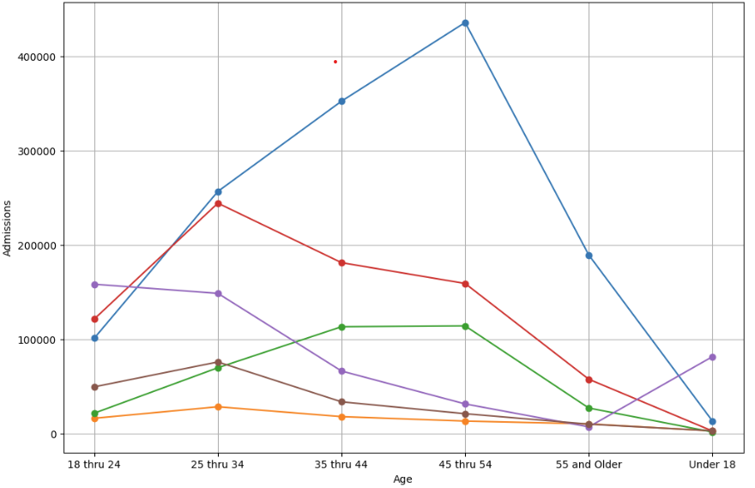
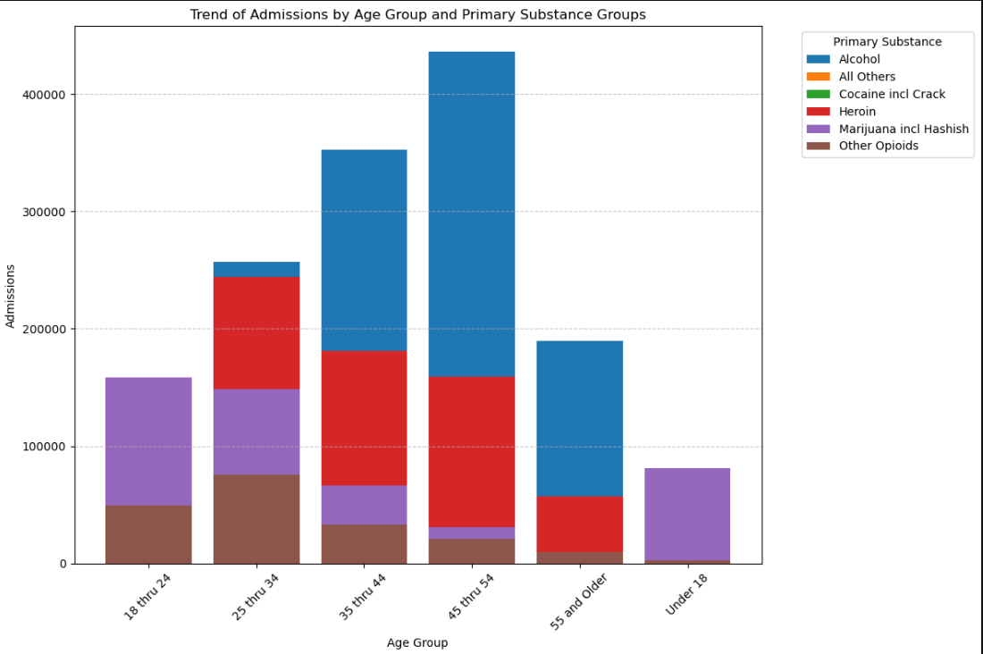
Admission by AGE
Alcohol admissions peak after age 25, likely due to life stressors and coping habits, while heroin holds steady across ages, often linked to people turning to it after prescription opioids become too pricey or hard to get—fueling the opioid crisis. These patterns highlight the need for age-specific interventions and assist with where to focus on prevention .
New York years 2007 - 2017
Notes:
Vis. 1: This breakdown by age group reveals a notable spike in alcohol admissions beginning at age 25, highlighting the influence of life transitions and stressors in adulthood. The visual also emphasizes substance patterns by age, showing how alcohol and heroin—closely tied to the opioid crisis—dominate among those aged 25-54. Analyzing these trends offers insight into how age-related factors shape substance abuse.
Vis. 2: This stacked bar chart provides a more detailed view of substance use by age group, underscoring the prominence of alcohol and heroin across different ages. Alcohol’s dominance is visible in older age groups, while heroin, often a substitute for prescription opioids, plays a significant role across younger and middle-aged adults, reflecting its connection to the opioid crisis.
Comparison of Visuals 2 and 3: Together, these visuals reveal both overall age trends and specific substance impact, building a comprehensive picture of substance use patterns and the underlying factors driving admissions by age.

Slide 7
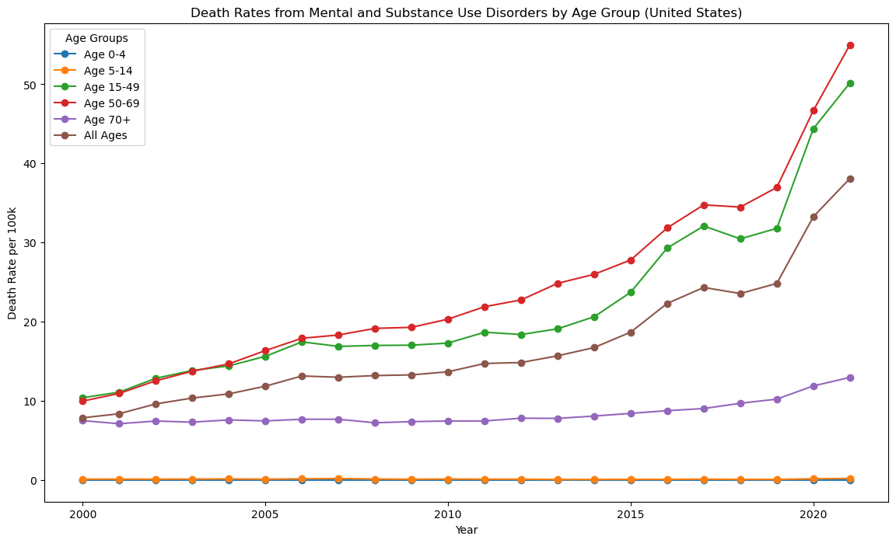
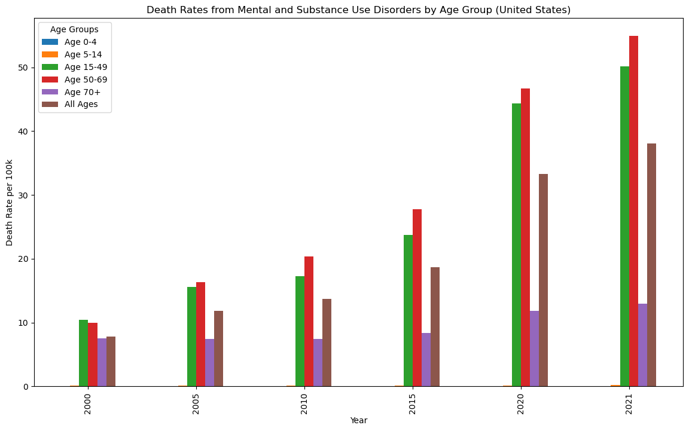
Death rate – Substance abuse + mental health by age | across the U.S.
Rising death rates from mental health and substance use disorders, especially among ages 15-49, reveal an urgent need for integrated mental health and rehab support.
Untreated mental health issues are increasingly linked to substance dependency, highlighting the need for comprehensive interventions to reduce mortality.
Notes:
Death rates from mental health and substance use disorders have increased dramatically across all U.S. age groups, with the steepest rise among those aged 15-49. From 2000 to 2021, younger adults and middle-aged individuals saw the most significant escalation, highlighting the dual impact of mental health struggles and substance use. The visuals show how, over time, mental health and substance-related deaths have become interlinked, reflecting a broader crisis where untreated mental health issues may lead to or worsen substance dependency.
For adults aged 30-49, death rates are now exceeding 40 per 100,000, indicating an urgent need for comprehensive mental health support and accessible rehab options. This trend echoes findings in New York's substance admission data, where high rates of substance dependency, especially with alcohol and heroin, suggest that untreated mental health issues could be a driving force behind increasing mortality. This data emphasizes the importance of integrating mental health treatment with substance abuse support to address the underlying causes and reduce mortality across age groups.

Slide 8

According to the National Institute on Drug Abuse (NIDA)
"Effective treatment for substance use disorders requires a comprehensive approach that includes access to rehabilitation facilities and evidence-based therapies."
Notes:
According to the National Institute on Drug Abuse (NIDA), "Effective treatment for substance use disorders requires a comprehensive approach that includes access to rehabilitation facilities and evidence-based therapies." As one of the leading authorities in addiction research, NIDA emphasizes that recovery is most successful when individuals have access to structured rehab programs that offer a range of treatments, from counseling and behavioral therapies to medication-assisted treatment. Their research suggests that without these resources, individuals struggling with substance use face significantly higher risks of relapse and mortality.
https://pmc.ncbi.nlm.nih.gov/articles/PMC3678283/#S3

Slide 9

Comparing 2 New York Counties: Erie & Westchester
Drug Rehabilitation Facilities
Despite similar populations, both counties have limited facility availability, emphasizing a statewide need for more rehab resources.
Notes:
Comparing facility access in Erie and Westchester highlights limited rehab availability for large populations. Despite similar populations, both counties have limited facility availability, emphasizing a statewide need for more rehab resources Population Similarity, Economic Difference:
Erie and Westchester have nearly identical populations, but their economic profiles differ significantly.
Westchester’s affluence, due to proximity to NYC, often enables better private healthcare access.
Erie, with a more industrial background and lower income levels, relies more on limited public rehab resources.

Slide 10
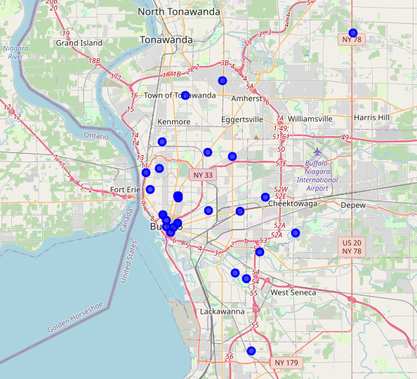

Erie County
32 facilities (population: 925,528) (admissions: 176,357)
Notes:
With only 1 facility for every 29,000 residents, Erie County’s rehab resources are stretched thin. This limited access highlights a critical shortage, leaving many without the support they need. Erie’s lower median income affects residents’ ability to afford private options, making the scarcity of public facilities even more critical.

Slide 11
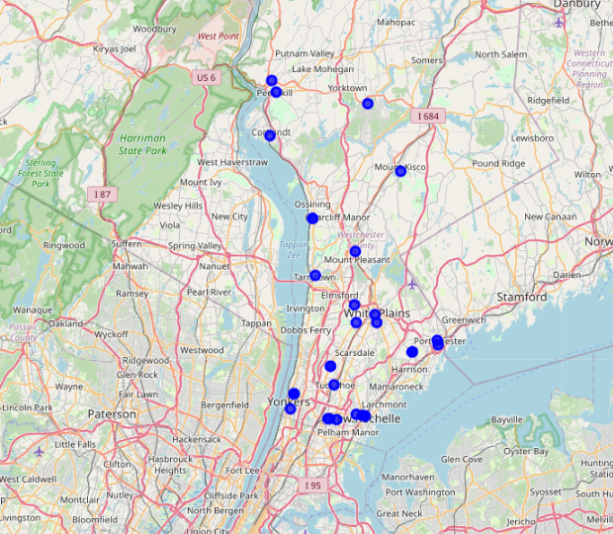
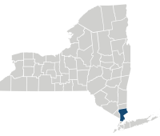
westchester County
35 facilities (population: 980,244) (admissions: 164,414)
Notes:
Westchester County faces a similar shortage, with just 1 facility for every 28,000 residents. Despite the high demand, treatment access remains severely constrained.
Higher incomes in Westchester can mean better access to private facilities, though access is still limited.

Slide 12

Bridging the Gap Making Recovery Accessible
The figures tell a clear story: without expanded access to treatment, the rising rates of substance-related deaths will continue unchecked.
Notes:
Rising substance-related deaths alongside declining rehab admissions, underscoring a critical gap.
Socioeconomic Barriers:
Facility numbers alone don’t solve the crisis; affordability and accessibility are essential, especially in diverse socioeconomic areas.
These differences highlight a need for targeted solutions, such as expanding affordable or subsidized rehab options.
Key Takeaway:
Substance abuse treatment must consider economic and social contexts. Addressing facility shortages with accessible, affordable treatment options is vital to closing the treatment gap.

Slide 13
questions

